Slide 1
Embedded System Design
PROJECT 1 : SAFE DISINFECTING DEVICE
BÜŞRANUR YILMAZ

Slide 2
PROJECT TOPIC
Using the Microwave Radar module, it is checked whether there are people or animals in sight.
When there is no moving person or animal, the UVC LED is activated and the UVC LED is turned on. Otherwise, the UVC LED remains off.
In this system, it is checked whether there is an object moving in the environment every 2 seconds.
Moving people or animal information and UVC LED status are sent to the server.

Slide 3
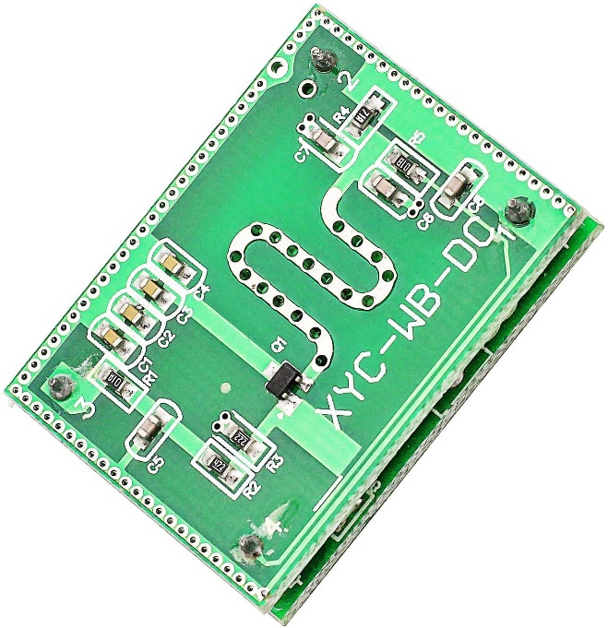
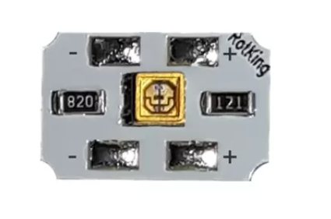
SENSORS
Microwave Radar Module
VCC → 3.3V
GND
OUT → ANALOG IN (PE3)
UVC LED
VCC → GPIO (PF1)
GND

Slide 4
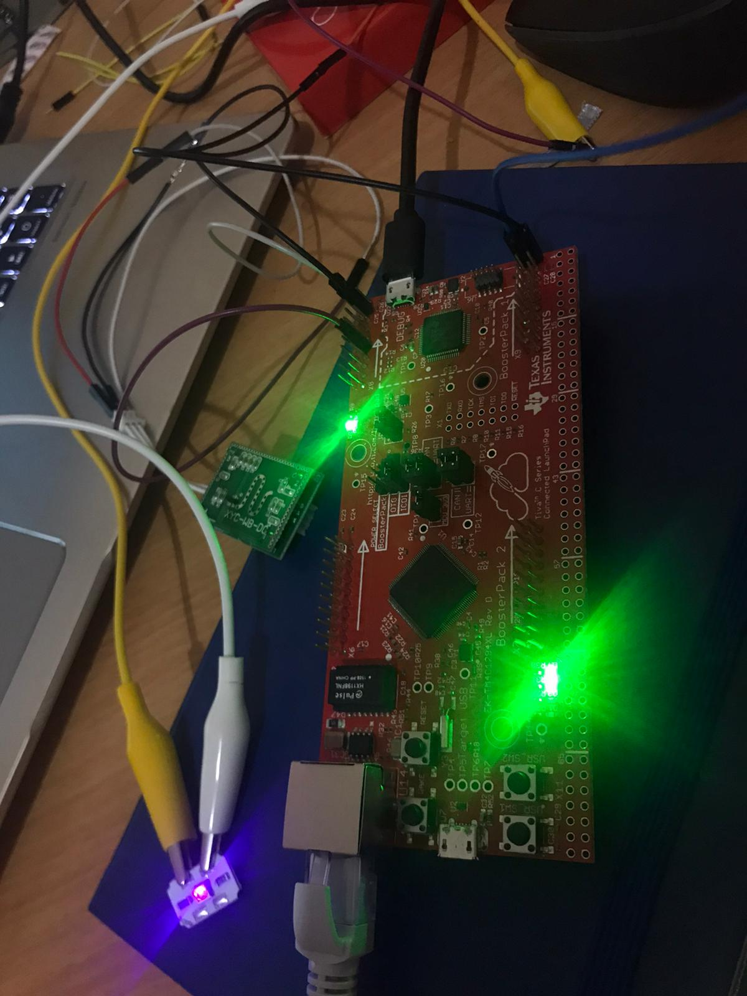
GENERAL SYSTEM DESIGN
Microwave Radar Module
UVC LED
Analog in
PE3
+3.3V
GND
GPIO out
PF1
GND

Slide 5
PROJECT BLOCK DIAGRAM
SWI
(ADC Value is Getting and Post by mailbox)
TASK
(UVC LED On/Off According to the ADC Value Sent by Mailbox)
HWI
(TIMER: ADC
Conversion is Started)
Main
(Initialize ADC and GPIO OUTPUT Configuration)
TASK
(With the socket created in the functionTimer task, it is connected to the NTP server from port 37. Time data from 1900 until now is taken in seconds.
TASK
(With the socket created in taskHercules, it is connected to the server from port 5011.)
HERCULES
(Time data and UVC LED information displayed on HERCULES screen)

Slide 6
TASK : taskLEDWrite
ADC values are between 0-4095.
If I read <10 UVC LED is ON. No people is around.
Otherwise UVC LED is OFF.
Post taskHercules task, send the UVC LED status information.
Task: functionTimer
Socket is created.
Connect "132.163.97.5» with 37 port.
Recv data from NTP server.
Calculate the seconds from 1/1/1990 and hold in global variable buffer[80]
TASK : taskHercules
Socket is created.
Connect "192.168.1.30» with 5011 port.
Post the functionTimer task for geting time information.
Send time and led information to the server.

Slide 7
PROBLEMS
Setting the GPIO pin as input
Creating a Task and Socket
TASK synchronization
Receiving data from NTP Server

Slide 8
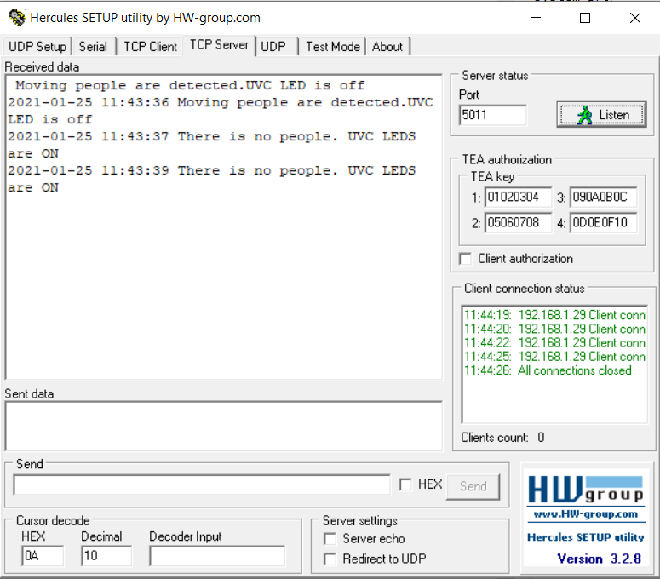

Slide 9
